Slide 1
IBM University Engagement Project Submission
“Exploring the Power of Agentic AI with IBM Granite and IBM Bob”

Slide 2

Project Tile – Krishi Niti - AI Agent for Smart Farming Advice
Domain of Project – Agriculture
Student Name | Recent Passport Photo | Email ID | Mobile number [WhatsApp]
VARUN R |  | pruthvivarunr@gmail.com | +91 9900954468

Slide 3
Problem Statement -
Problem Statement : AI Agent for Smart Farming Advice
The Challenge
An AI Agent for Smart Farming Advice, powered by RAG (Retrieval-Augmented Generation), supports small-scale farmers by delivering real-time, localized agricultural guidance. It retrieves trusted data on weather forecasts, soil conditions, crop recommendations, pest control measures, and current market prices from agricultural departments, meteorological sources, and agri tech platforms. Farmers can interact in their local language and ask questions like “What crop is best for this season?” or “What is today’s mandi rate for tomatoes?” The agent ensures timely, data-driven decisions that reduce risk, increase yield, and boost income. This AI-driven assistant bridges the knowledge gap and brings smart farming to the grassroots.
Objective:
To develop an AI-powered smart farming assistant that provides small-scale farmers with reliable, localized, and actionable agricultural guidance using RAG and IBM Granite.
Key Objectives:
Recommend suitable crops based on season, location, soil conditions, and water availability.
Provide guidance on soil management, irrigation, pests, and crop diseases.
Retrieve trusted agricultural information before generating recommendations.
Generate clear, context-aware responses using IBM Granite.
Support interaction in local/regional languages.
Reduce uncertainty and help farmers make better data-driven decisions.
This reflects the intended solution areas of crop selection, weather, soil, pest management, and market information.

Slide 4
Proposed Solution -
KrishiNiti AI – AI-Powered Smart Farming Assistant
KrishiNiti AI is a RAG-based AI farming assistant designed to help small-scale farmers make informed decisions through natural-language interaction.
The system follows this workflow:
Farmer Query → Query Understanding → RAG Retrieval → Relevant Agricultural Context → IBM Granite → Actionable Farming Advice
The application retrieves relevant information from a trusted agricultural knowledge base using semantic search and then provides a context-aware response using IBM Granite.
The solution covers crop selection, soil and irrigation management, pest and disease guidance, weather-aware farming, and agricultural market information.
The system combines React + TypeScript for the user interface, FastAPI for backend processing, ChromaDB as the vector database, and IBM watsonx.ai / Granite for AI generation and embeddings.
This follows the source material's core flow of trusted agricultural data → RAG retrieval → IBM Granite → farming recommendation.

Slide 5
Technology Used
IBM Bob platform -For designing and orchestrating multi-agent workflows visually
IBM Grainte model - for eg – ibm-granite-3-2-8b – For natural language understanding, reasoning, and personalization
IBM Cloud – It provides the infrastructure to build, deploy, and scale the Nutrition Agent efficiently. IBM Cloud enables a reliable, secure, and scalable environment for deploying the Nutrition Agent.
RAG– RAG to fetch real data first, then generate intelligent answers, making the Nutrition Agent more trustworthy and effective.
IBM Watsonx.ai - For model deployment, embeddings, and AI governance
Vector Database (FAISS/Chroma) – For RAG-based nutritional data retrieval

Slide 6
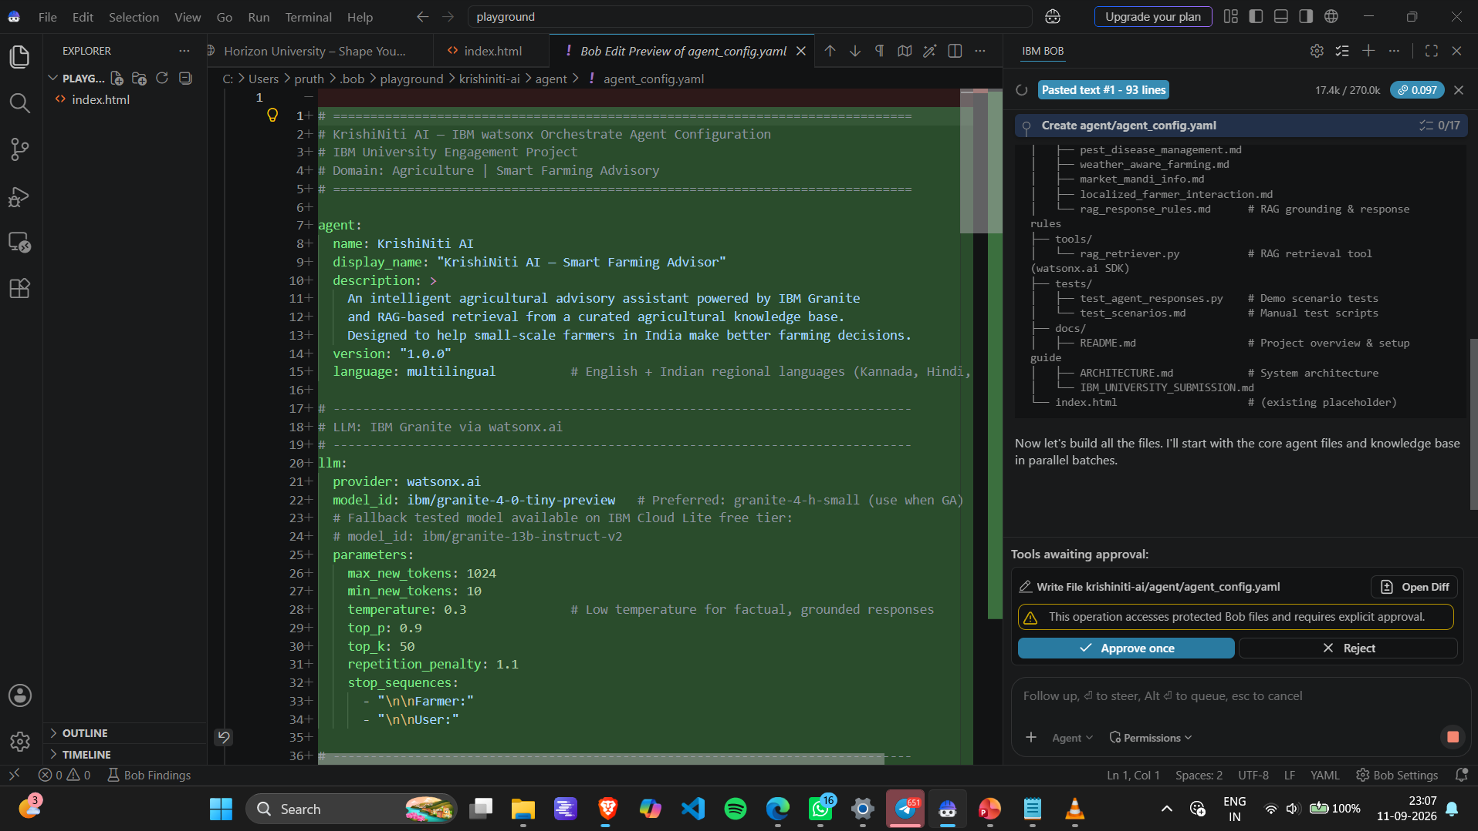
Required Files created using IBM bob -

Slide 7
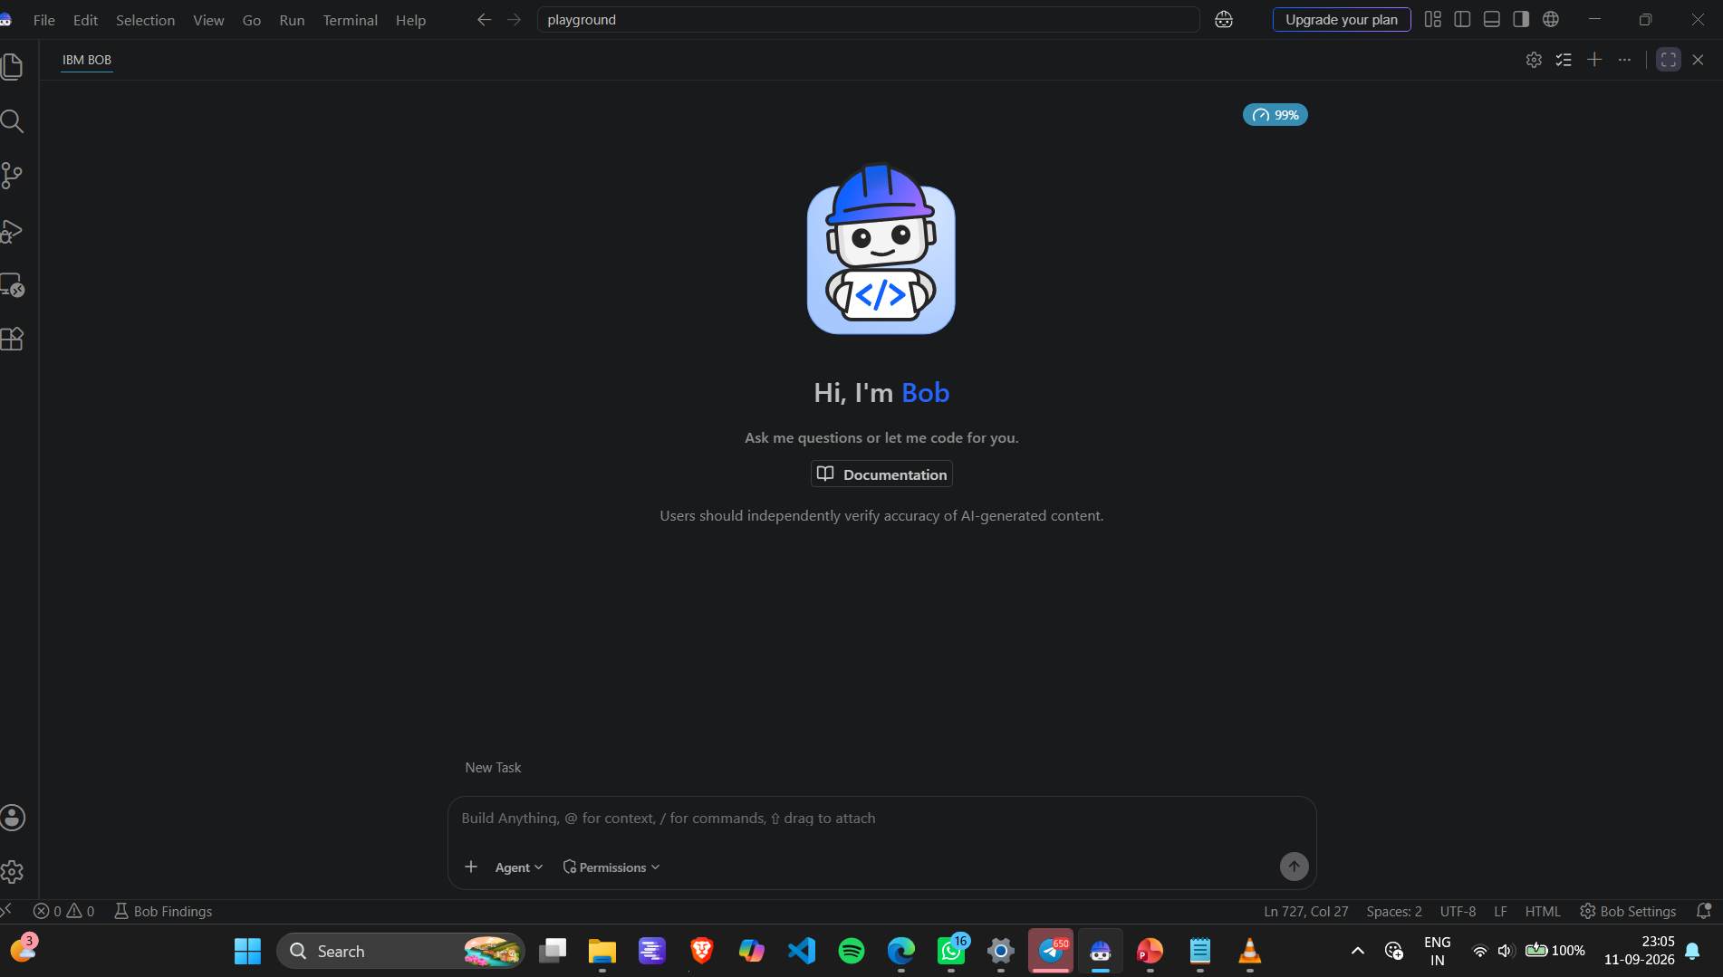
IBM Bob Screenshots:

Slide 8
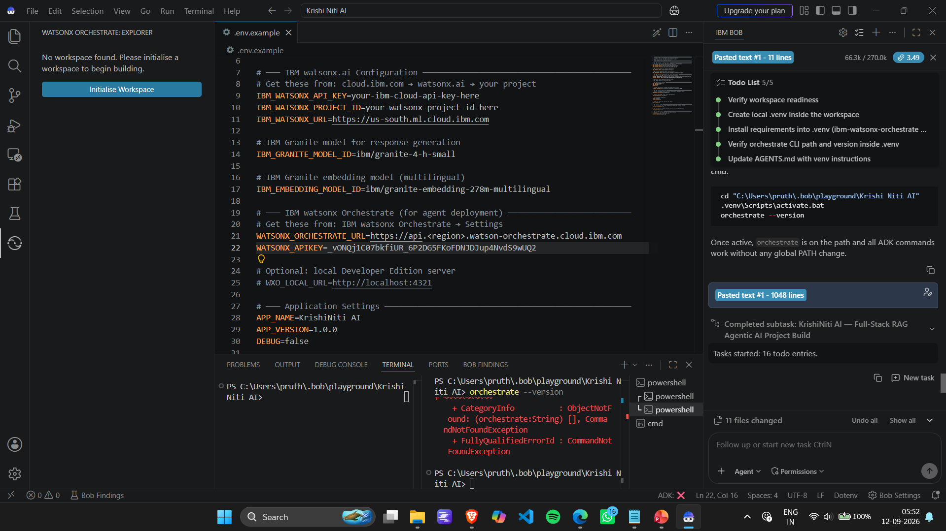

Slide 9
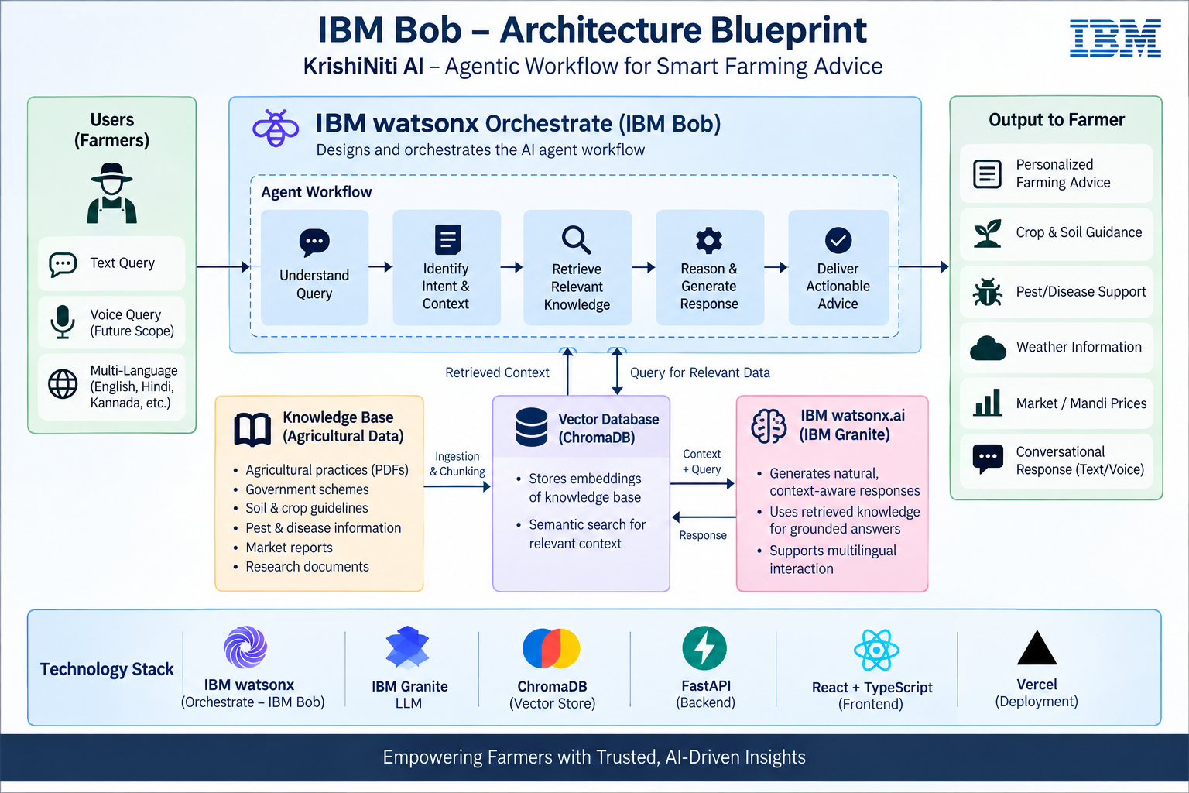
Architecture blueprint for IBM bob:

Slide 10

Role of Agentic AI in the solution
Role of Agentic AI in the Solution
Agentic AI makes KrishiNiti AI more than a simple question-answer chatbot by allowing the system to perform a multi-step decision workflow.
Key Roles
1. Query Understanding
Understands the farmer's question and identifies the type of agricultural information required.
2. Context Identification
Uses details such as crop, season, location, soil, and irrigation conditions when provided.
3. Intelligent Retrieval
Retrieves the most relevant agricultural knowledge from the vector database using RAG.
4. Context-Aware Reasoning
IBM Granite analyzes the farmer's query together with the retrieved information.
5. Recommendation Generation
Converts the retrieved knowledge into practical and understandable farming guidance.
6. Responsible Decision Support
Avoids fabricating unavailable live information, such as current mandi prices, and communicates limitations when required.
The project material similarly describes the agentic workflow as query understanding, information retrieval, context-aware reasoning, multi-step decision making, and personalized recommendations.

Slide 11
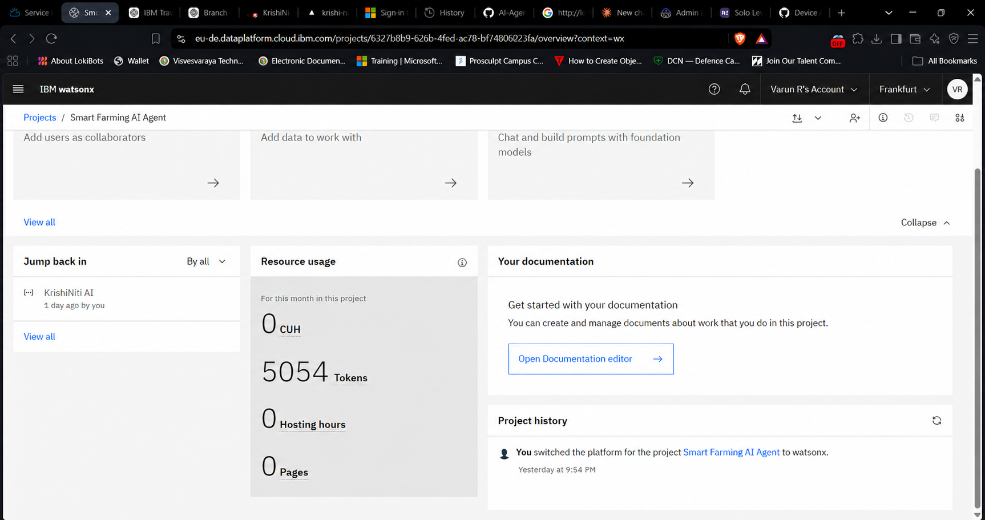
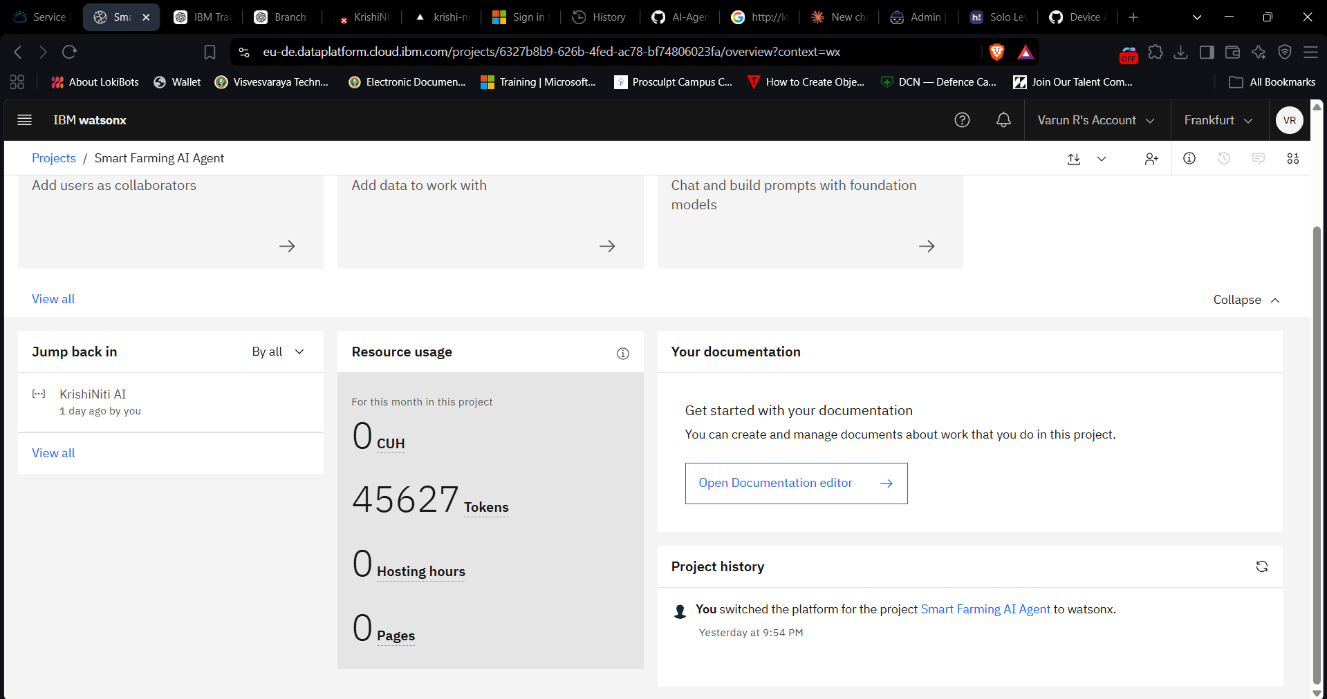
Token Usage
11,761 token are used
Before Prompt
After the Prompt
·
·
·

Slide 12
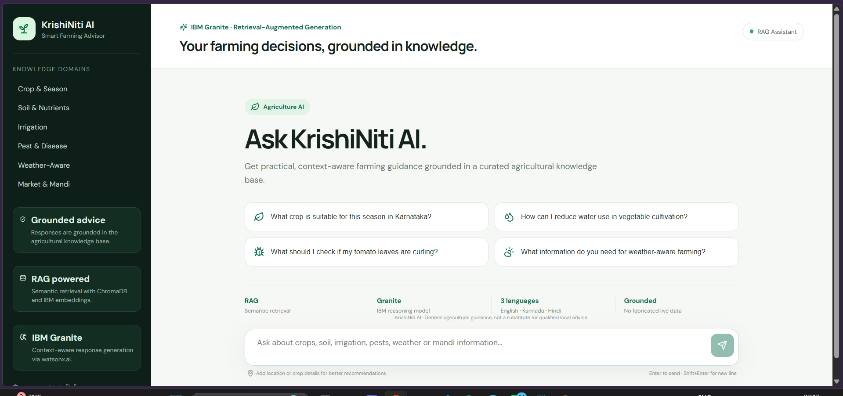
Project Output Screenshot

Slide 13
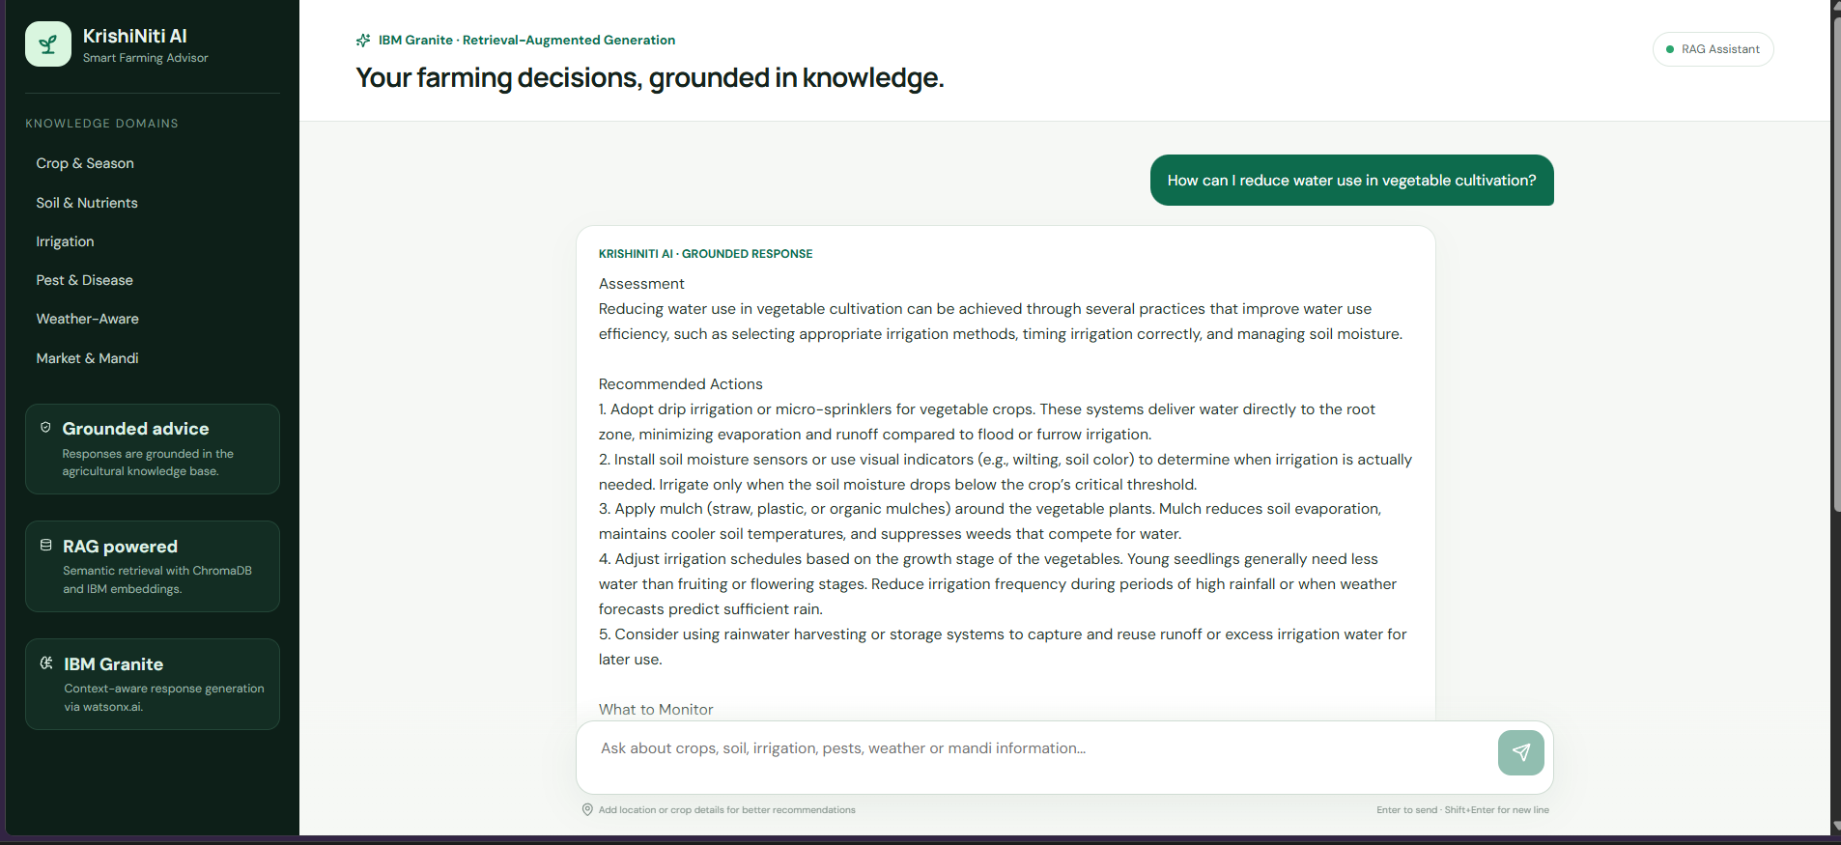
Project Output Screenshot
·
·
·

Slide 14
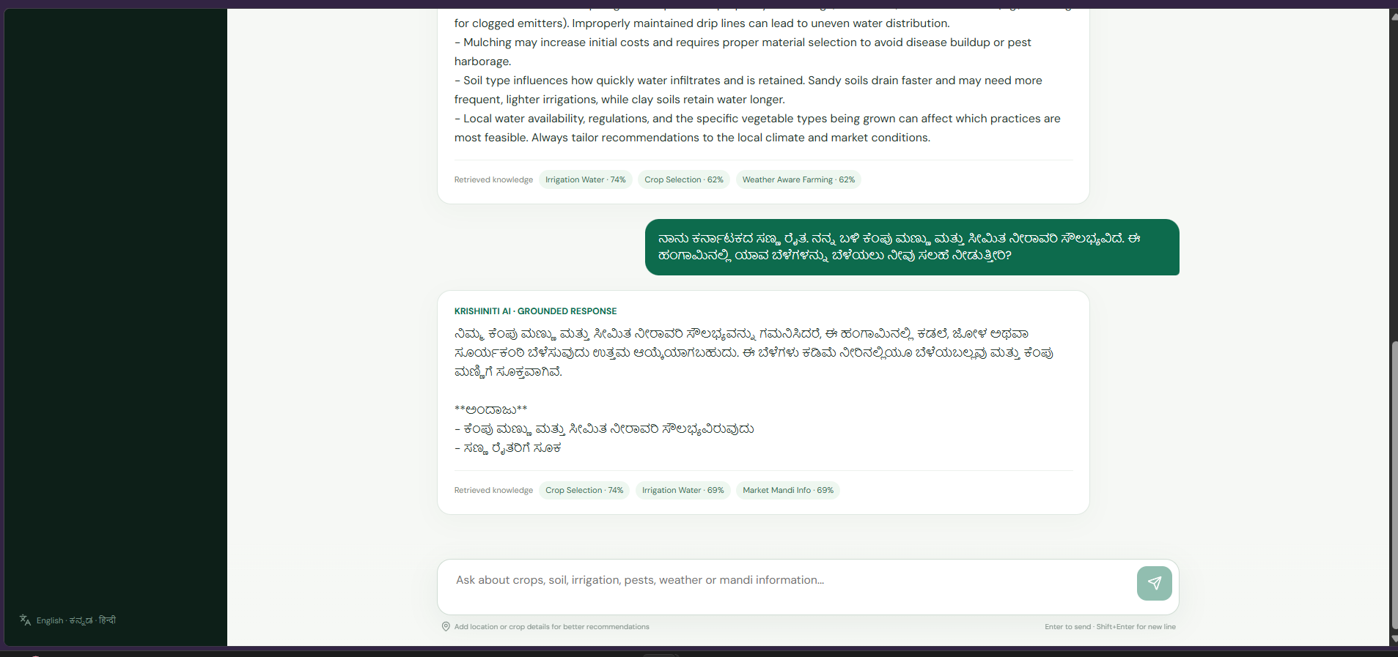
Project Output Screenshot

Slide 15
Novelty and Uniqueness
What Makes KrishiNiti AI Different?
1. RAG-Based Agricultural Intelligence
Instead of relying only on the model's internal knowledge, the system retrieves relevant agricultural information before generating its response.
2. IBM Granite-Powered Reasoning
IBM Granite is used to generate context-aware and natural-language farming guidance.
3. Multi-Domain Farming Support
A single assistant addresses multiple agricultural needs:
Crop and seasonal planning, Soil and irrigation, Pest and disease management, Weather-aware guidance
Market and mandi information
4. Localized Farmer Interaction
The system can respond to farmers in regional languages and adapt recommendations to the context supplied by the farmer.
5. Trusted Knowledge Retrieval
Relevant information is retrieved from a dedicated agricultural knowledge base, improving grounding and reducing unsupported answers.
6. Responsible AI Behavior
The system is designed not to invent live weather, market prices, or unsupported agricultural claims, providing safer decision support.

Slide 16
Git Hub Link
The GitHub Repo of KrishiNiti AI Agent :
https://github.com/varun14r/KrishiNiti-AI

Slide 17
Future Scope
Real-Time Weather & Mandi Integration
Connect live weather forecasts and mandi-price APIs for timely, location-based farming and selling decisions.
Multilingual Voice Assistant
Enable farmers to interact through regional-language voice input and audio responses.
AI-Based Crop Disease Detection
Allow farmers to upload crop images for identifying possible diseases, pests, and crop damage.
IoT & Personalized Smart Farming
Integrate soil sensors and farmer-specific data to provide real-time soil monitoring and personalized recommendations.

Slide 18
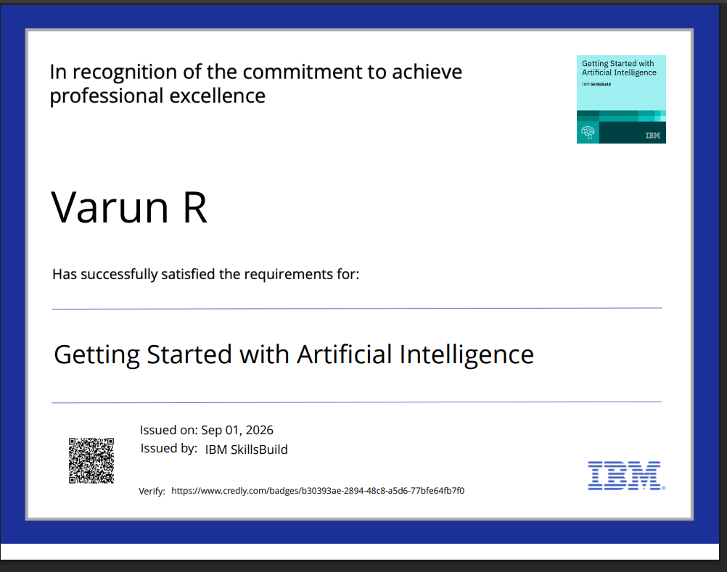
Certificates Earned:
Credly certificate(Getting Started with Artificial Intelligence)

Slide 19
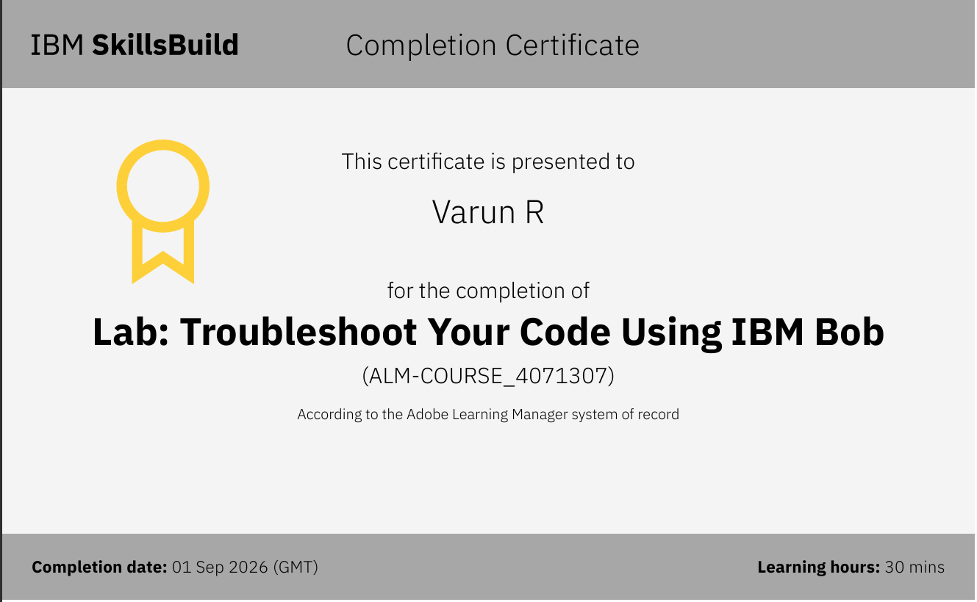
Certificates Earned:​
IBM BOB Certificate

Slide 20


